Slide 1

BIG DATA TOOLS FOR MANAGERS
Unit-2 : Data Retrieval using MySQL
by
Ankit Velani
Adjunct Faculty, Dept. of MBA,
Siddaganga Institute of Technology,Tumkur

Slide 2
Data
Data is a collection of a small piece of information. It can be used in a variety of forms like text, numbers, media, bytes…etc
i.e. Student data, Employee data, Events data, Travelling data

Slide 3
Database
A database is an organized collection of data so that it can be easily managed and accessible.
Student data
Employee data
Event data
Database
Movies data
Exam data
Sports data

Slide 4
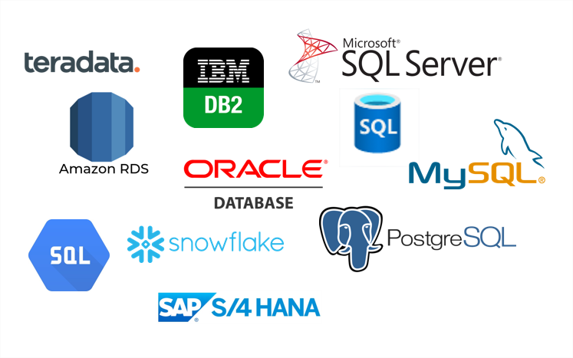
DBMS
Data Base Management System is software used to store and retrieve the database.

Slide 5
RDBMS
Relational Data Base Management System
All the modern database systems like MySQL, ORACLE…etc are based on RDBMS.
In RDBMS, data are stored in form of Tables, and it allows to create relationships between tables.

Slide 6
RDBMS
Emp_ID | ENAME | POST | CITY
E1 | John | Manager | USA
E2 | Nick | Data Analyst | UK
E3 | Dom | Product Owner | UK
E4 | Paul | Project Owner | UK

Slide 7
RDBMS
Columns/ Attributes/ Fields
Emp_ID | ENAME | POST | CITY
E1 | John | Manager | USA
E2 | Nick | Data Analyst | UK
E3 | Dom | Product Owner | UK
E4 | Paul | Project Owner | UK
Records/
Tuples/
Rows

Slide 8
Table Creation
CREATE TABLE table_name (
col-name-1 data-type
col-name-2 data-type,
col-name-3 data-type,
col-name-4 data-type
);

Slide 9
Table Creation
CREATE TABLE table_name (
col-name-1 data-type
col-name-2 data-type,
col-name-3 data-type,
col-name-4 data-type
);
CREATE TABLE employee (
emp_id text,
ename text,
post text,
city text
);

Slide 10
Insert Records/Rows
INSERT INTO table_name VALUES (‘value-1’, ‘value-2’,……);
INSERT INTO employee VALUES ( ‘E1’,
‘John’,
‘Manager’,
‘USA’
);

Slide 11
Retrieve Data using SELECT
SELECT * FROM table_name;
(asterisk) represent all the columns
from table

Slide 12
Retrieve Data using SELECT
SELECT * FROM table_name;
SELECT * FROM employee;
SELECT ename FROM employee;
SELECT ename, city FROM employee;

Slide 13
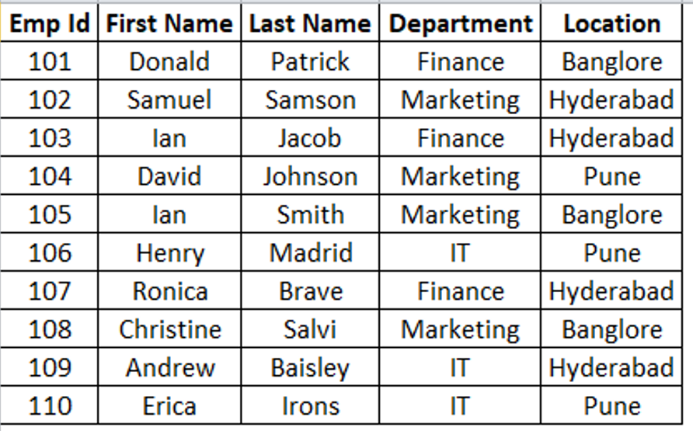
Create Employee_2 table in SQL

Slide 14
MySQL Data Types
The data type of a column defines what value the column can hold: integer, character, money, date and time, binary, and so on.
Each column in a database table is required to have a name and a data type.
In MySQL there are three main data types: string, numeric, and datetime.

Slide 15
String Types
CHAR(size)
A fixed-length string between 1 and 255 characters in length (for example CHAR(5)), right-padded with spaces to the specified length when stored
Example:
CREATE TABLE student(
usn CHAR(10)
);

Slide 16
String Types
VARCHAR(size)
A variable-length string between 1 and 255 characters in length.
Example:
CREATE TABLE student(
usn VARCHAR(10)
);

Slide 17
String Types
TINYTEXT
TEXT column with a maximum length of 255 characters
MEDIUMTEXT
TEXT column with a maximum length of 16777215 characters
LONGTEXT
TEXT column with a maximum length of 4294967295 or 4 GB of characters

Slide 18
String Types
Example:
CREATE TABLE student (
usn CHAR(10),
name VARCHAR(50),
address TINYTEXT,
city VARCHAR(20),
state VARCHAR(20),
pincode CHAR(5)
);

Slide 19
Numeric Types
Data Type | Signed range(Number with Sign) | Unsigned range
TINYINT | -128 to 127 | 0 to 255
SMALLINT | -32768 to 32767 | 0 to 65535
MEDIUMINT | -8388608 to 8388607 | 0 to 16777215
INT | -2147483648 to 2147483647 | 0 to 4294967295
BIGINT | -9223372036854775808 to 9223372036854775807 | 0 to 18446744073709551615
FLOAT | Decimal precision can go to 24 places for a float type
DOUBLE | Decimal precision can go to 53 places for a double

Slide 20
Recap…
String Data Type:
CHAR
VARCHAR
TINYTEXT
MEDIUMTEXT
LONGTEXT
Numeric Data Type:
TINYINT
SMALLINT
MEDIUMINT
INT
BIGINT
FLOAT
DOUBLE
Date Data Type:
DATE
TIME
DATETIME
TIMESTAMP

Slide 21
DateTime Types
Data Type Syntax | Maximum Size
DATE | Values range from '1000-01-01' to '9999-12-31'.
TIME | Values range from '-838:59:59' to '838:59:59'.
DATETIME | Values range from '1000-01-01 00:00:00' to '9999-12-31 23:59:59'.
TIMESTAMP | Values range from '1970-01-01 00:00:01' UTC to '2038-01-19 03:14:07’ UTC.

Slide 22
Example : String, Int, and DateTime
Example:
CREATE TABLE students (
usn CHAR(10),
name VARCHAR(50),
dob DATE,
age TINYINT,
degree_per FLOAT,
address MEDIUMTEXT
);

Slide 23
String, Int, and DateTime
** Numeric data should be without single or double quotes.
Example:
INSERT INTO students
VALUES (
'MBA01',
'Paul S',
'1991-09-08',
30,
70.80,
'B.H. Road, Tumkur 572103, Karnataka’
);

Slide 24
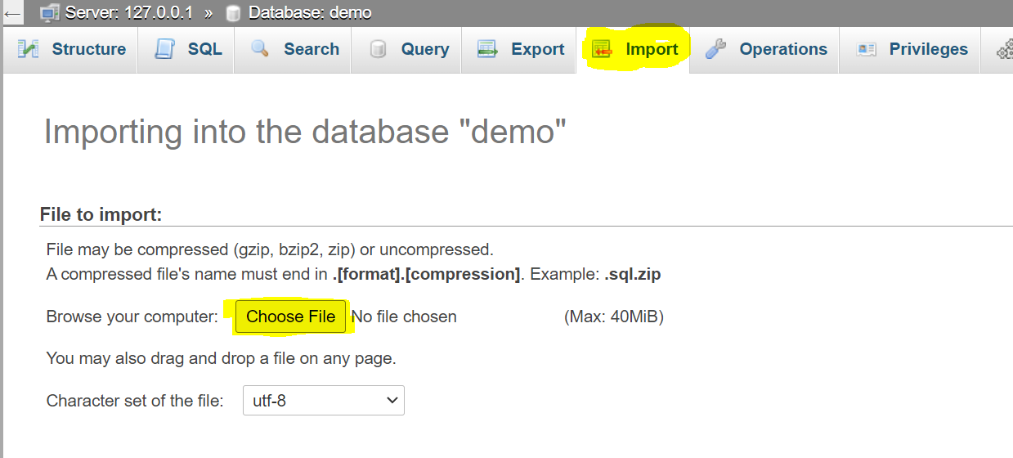
Import data in MySQL
Download customer.sql file :
https://raw.githubusercontent.com/sitmbadept/sitmbadept.github.io/main/BDTM/SQL/customers.sql

Slide 25
Describe Table
DESCRIBE statement used to view the structure of a table in MySQL.
Syntax:
DESCRIBE table_name;
Example:
DESCRIBE customers;

Slide 26
SELECT Statement
The SELECT statement is used to select data from a database.
The data returned is stored in a result table, called the result-set.
Syntax
SELECT
column1, column2, column3,... FROM table_name;

Slide 27
SELECT Statement
Example
Display all the records & columns from Table:
SELECT * FROM customers;
Display all the records and selected column from Table:
SELECT
customerNumber,
customerName
FROM customers;

Slide 28
SELECT DISTINCT Statement
The SELECT DISTINCT statement is used to return only distinct (different) values.
Syntax
SELECT DISTINCT
column1, column2, column3,... FROM table_name;

Slide 29
SELECT DISTINCT Statement
Example:
Display all the countries from the country column in customers table.
SELECT country FROM customers;
Display unique/distinct countries from the country column in customers table
SELECT DISTINCT country FROM customers;

Slide 30
SELECT DISTINCT Statement
Example:
Display values for city and country columns from customers table.
SELECT city, country FROM customers;
Display unique/distinct values for city and country columns from customers table.
SELECT DISTINCT city, country FROM customers;

Slide 31
SELECT DISTINCT Statement
Example:
SELECT DISTINCT
city, state, postalCode, country
FROM customers;

Slide 32
Working with large text data
Download post.sql file from below link and import into phpMyAdmin
https://raw.githubusercontent.com/sitmbadept/sitmbadept.github.io/main/BDTM/SQL/post.sql
Execute SQL queries for following:
View Table Structure
View the table data

Slide 33
SQL WHERE Clause
The WHERE clause is used to filter records.
It is used to extract only those records that fulfill a specified condition.
WHERE Syntax:
SELECT
column1, column2, ... FROM table_name WHERE condition;

Slide 34
SQL WHERE Clause
The WHERE clause is used to filter records.
It is used to extract only those records that fulfill a specified condition.
WHERE Syntax:
SELECT
column1, column2, ... FROM table_name WHERE condition;

Slide 35
SQL WHERE Clause
The following operators can be used in the WHERE clause:
Operator | Description
= | Equal
> | Greater than
< | Less than
>= | Greater than or equal
<= | Less than or equal
<> | Not equal. Note: In some versions of SQL this operator may be written as !=
BETWEEN | Between a certain range
LIKE | Search for a pattern
IN | To specify multiple possible values for a column

Slide 36
SQL WHERE Clause
Condition can be apply in multiple columns using AND OR operators.
AND operator displays a record if all the conditions separated by AND are TRUE.
OR operator displays a record if any of the conditions separated by OR is TRUE.

Slide 37
SQL WHERE Clause
Example:
SELECT * FROM `customers` WHERE country = 'USA’;
SELECT * FROM customers
WHERE creditLimit BETWEEN 10000 AND 50000;

Slide 38
Recap…
String, Number and Date data types
Create Table
Insert data (String, Number, Date)
Import Data
Select DISTINCT
WHERE Clause

